Slide 1


SMART INDIA HACKATHON 2025
Problem Statement ID – 25059
Problem Statement Title - Enhancing Student Awareness on difference between Aadhaar linked and Direct Beneficiary Transfer(DBT) enabled Aadhaar seeded bank account.
Theme - Miscellaneous
PS Category - Software
Team ID -
Team Name - Hacktivators

Slide 2
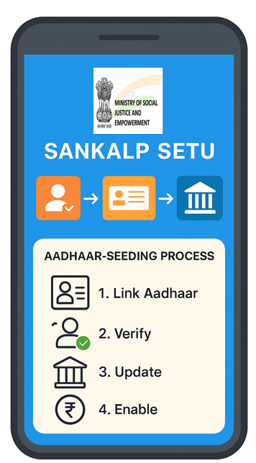
IDEA &APPROACH
HACKTIVATORS
IDEA
“Gyan Doot” is a community-driven digital awareness platform that simplifies Aadhaar–DBT seeding for students and parents. It combines QR-based access, interactive visual guides, gamification and progress dashboards to make the process engaging, inclusive, and trackable.
APPROACH
Access via QR Code
Simple entry point → scan and open the web app.
Interactive Visualizer
Step-by-step journey of Aadhaar seeding in an easy, localized format.
Digital Guides & Videos
Pictorial/animated resources for clarity in multiple languages.
Credential Motivation
Digital tokens/badges for students to encourage participation.
Community Progress Tracker
A digital Sankalp Tree grows as students complete seeding.
Real-time Dashboard
Schools and teachers can monitor seeded vs pending accounts.

Slide 3
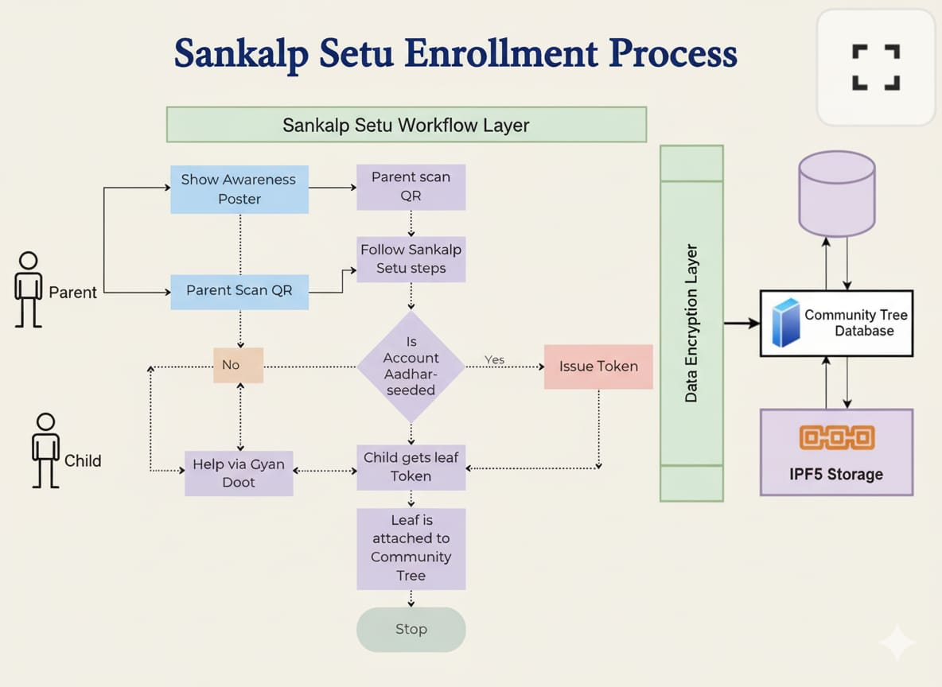

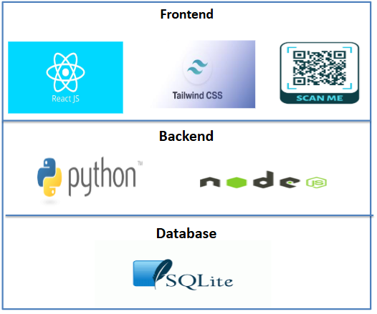
TECHNICAL APPROACH
HACKTIVATORS

Slide 4
FEASIBILITY AND VIABILITY
HACKTIVATORS
Analysis of Feasibility
Uses widely available smartphones and internet.
Web-based app is scalable & easy to maintain.
Remote updates simplify deployment.
Easy access to the “SANKALP SETU” web page through QR codes.
Challenges & Risks
Internet/device access gaps in some areas.
Digital literacy hurdles for some users.
Data privacy and security concerns online.
Strategies to Overcome
Optimize app for low bandwidth and basic devices.
Use clear multilingual guides & help support.
Implement strong security & transparent privacy policies.

Slide 5
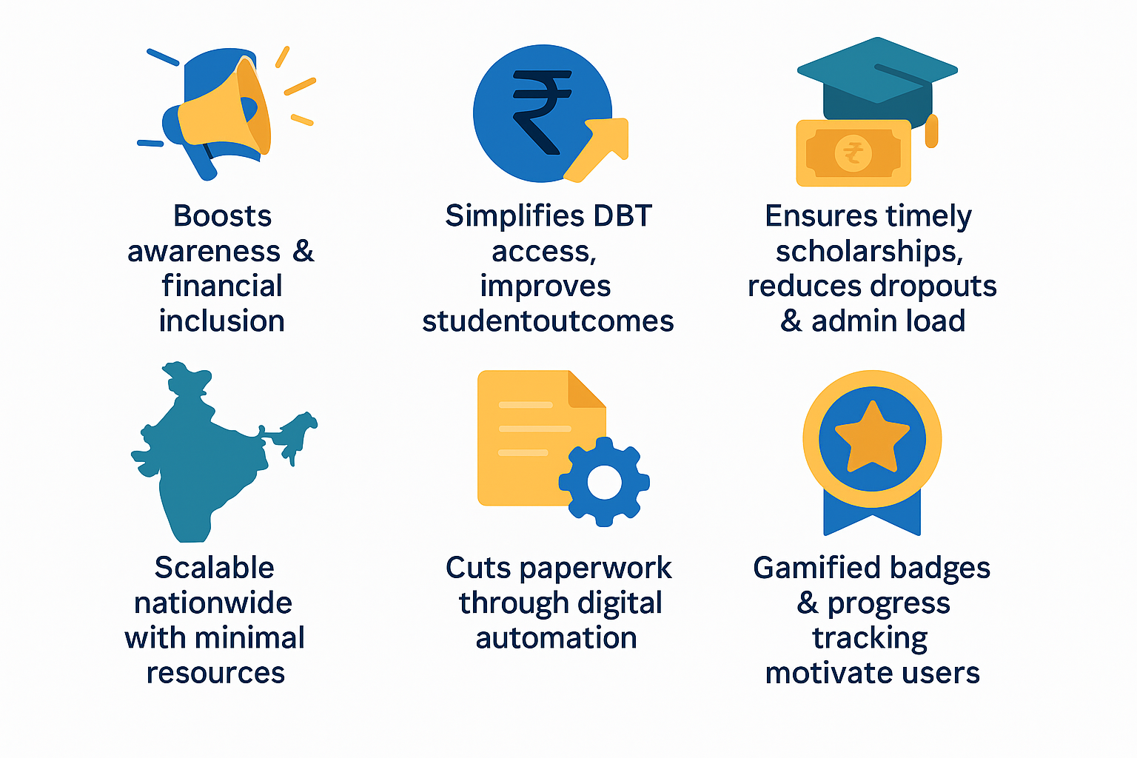


IMPACT AND BENEFITS
HACKTIVATORS

Slide 6
RESEARCH AND REFERENCES
HACKTIVATORS
India’s DBT: Boosting Welfare Efficiency / PIB:
https://www.pib.gov.in/PressReleasePage.aspx?PRID=2123192&utm_source=chatgpt.com
Aadhaar usage – UIDAI official page:
https://uidai.gov.in/en/my-aadhaar/about-your-aadhaar/usage-of-aadhaar.html?utm_source=chatgpt.com
Aadhaar Seeding in Bank Accounts:
https://myaadhaar.uidai.gov.in/bank-seeding-status
AI TOOLS USED:
CLAUDE
SONNET 4
GEMINI
2.5 FLASH
PERPLEXITY
WHIMSICAL
CHATGPT
GPT-5

Slide 7
IMPORTANT INSTRUCTIONS
Please ensure below pointers are met while submitting the Idea PPT:
Kindly keep the maximum slides limit up to six (6). ( Including the title slide)
Try to avoid paragraphs and post your idea in points /diagrams / Infographics /pictures
Keep your explanation precise and easy to understand
Idea should be unique and novel.
You can only use provided template for making the PPT without changing the idea details pointers (mentioned in previous slides).
You need to save the file in PDF and upload the same on portal. No PPT, Word Doc or any other format will be supported.
Note - You can delete this slide (Important Pointers) when you upload the details of your idea on SIH portal.

